Slide 1
Soil Moisture Sensor Using Arduino

Slide 2
Team
Viraj Deshmukh
Indraneel Kadam
Aditya Gokhale
Pratik Jadhav
Aditya Chougule

Slide 3
Introduction
Welcome to our presentation on "Soil Moisture Sensor Using Arduino."
This project aims to create an automated system to monitor and maintain soil moisture levels in a garden or agricultural field.
By using an Arduino microcontroller and a soil moisture sensor, we can ensure optimal conditions for plant growth and water conservation.

Slide 4
Project Components
- Arduino Board (e.g., Arduino Uno or Arduino Nano)
- Soil Moisture Sensor Module
- Jumper Wires
- Breadboard (optional)
- Water pump (optional, for automated irrigation)
- 5V Relay Module (optional, for controlling the water pump)
- Power Source (e.g., USB cable or 9V battery)

Slide 5
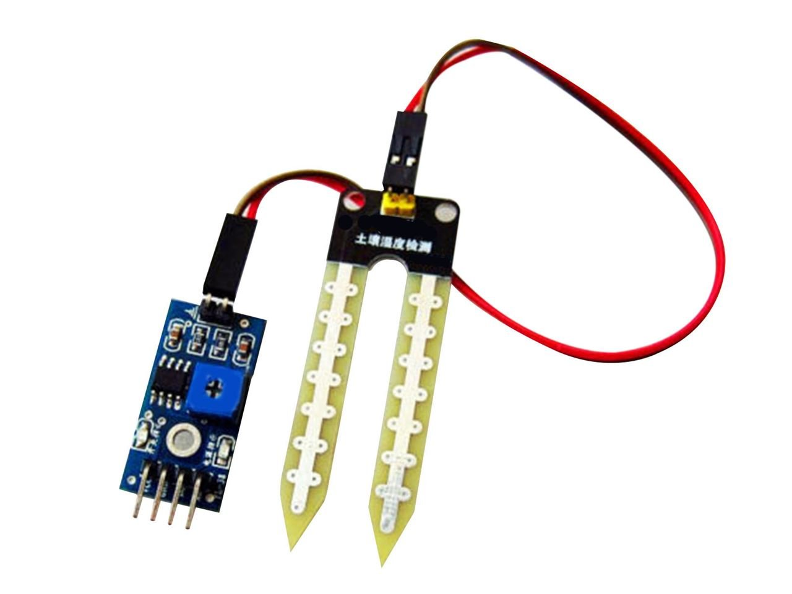
Understanding Soil Moisture Sensor
- The soil moisture sensor measures the water content in the soil.
- It consists of two conducting probes that are inserted into the soil.
- As the soil moisture level increases, the electrical conductivity between the probes changes.
- The Arduino reads this value and converts it into a meaningful moisture level

Slide 6
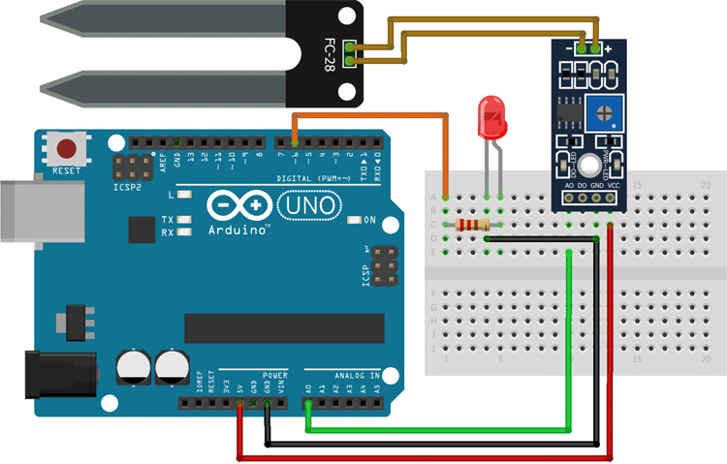
Arduino Setup
Connect the soil moisture sensor to the Arduino board as follows:
- VCC pin to 5V
- GND pin to GND
- A0 pin to analog input A0
If using a water pump for automated irrigation:
- Connect the pump to an external power source (if required).
- Connect the pump control pin to a digital pin on the Arduino (e.g., D7).
- Connect the pump's ground pin to the Arduino GND pin.

Slide 7
Working Principle
- The Arduino reads the analog output from the soil moisture sensor.
- It converts the reading into a percentage value to indicate the soil moisture level.
- If the moisture level falls below a predefined threshold, the Arduino activates the water pump for a specified duration.
- The pump adds water to the soil until the moisture level reaches an acceptable range.

Slide 8
Benefits and Applications
Benefits:
- Water Conservation: Prevents overwatering by supplying water only when needed.
- Improved Plant Health: Maintains the optimal soil moisture level for healthy plant growth.
- Automation: Reduces manual intervention and ensures consistent care for plants.
Applications:
- Home Gardens
- Agricultural Fields
- Greenhouses
- Nurseries

Slide 9
Enhancements and Customizations
- Extend the system with additional sensors like temperature and humidity for more precise control.
- Implement a display module (LCD, OLED, etc.) to show real-time moisture levels and system status.
- Integrate wireless communication (e.g., Wi-Fi or Bluetooth) to monitor and control the system remotely through a smartphone or computer.

Slide 10
Conclusion
- Soil moisture sensors using Arduino offer an efficient and smart solution for maintaining the ideal moisture levels in gardens and agricultural fields.
- This project promotes water conservation, reduces manual effort, and ensures healthy plant growth.
- With potential customizations, it can be adapted to various applications and environments.

Slide 11
Thank you

